Slide 1
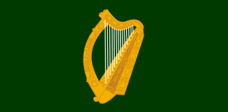
The Harp In Ireland:
Strings of a Nation
Presented by Kristin Gleeson
PhD. History & harper

Slide 2
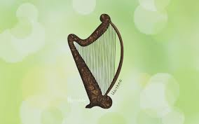
Introduction
The harp has long held a significant place in Ireland and Irish culture.
Distinct from continent- unique status, design, technique, & repertoire.
Always accorded professional status and from 11th c. onward had an exalted position.
Depicted in early Irish myths- Uaithe was the name of Dagda’s harp- helped defeat the enemy.

Slide 3
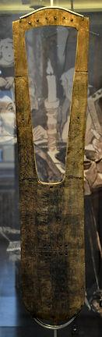
Early Medieval Depictions
8th c. reference to 3 kinds of music: Joyful, sorrowful and sleep (súantraige, goltraige and gentraige).
Cruit player elite performer, esteemed beyond all other musicians.
Cruit (old Irish) appears to be a lyre, a four sided instrument-- soundbox parallel to the strings, unlike the harp’s which is perpendicular.
10th century Celtic crosses show lyre shape.

Slide 4
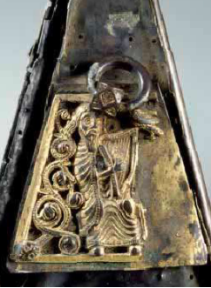
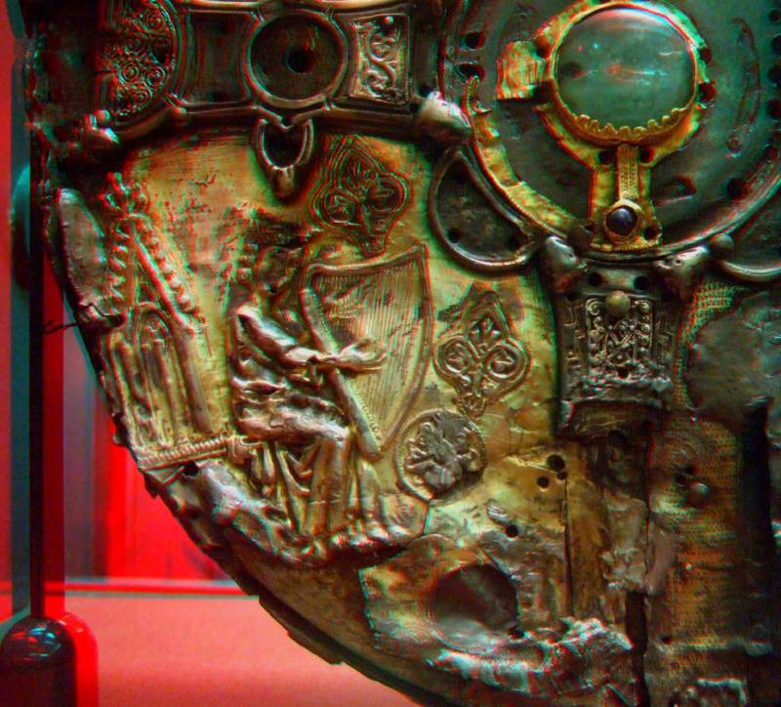
Triangular harp
Gradually instrument became associated with triangular framed harps.
Earliest representation of triangular harp in Ireland is the 11thc gilded silver plate representation on Shrine of St Mogue
Depiction on 14th century Shrine of St Patrick’s Tooth
Late 12th c. Gerald of Wales describes Irish music - 2 instruments are used, one of which (cithara) is assumed to mean harp. Metal strings are used instead of gut.

Slide 5
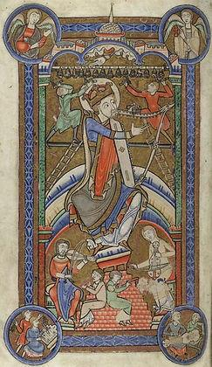
Later Medieval Role
By 14th c. came to be known as cláirseach
Attached to retinues of kings and chiefs –only musicians formally trained.
Trained aurally.
Besides playing the 3 types of music harpers used to accompany reacaire (reciters) who would recite the poetry composed by the filidh (poets)

Slide 6
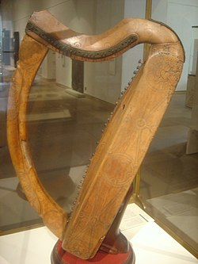
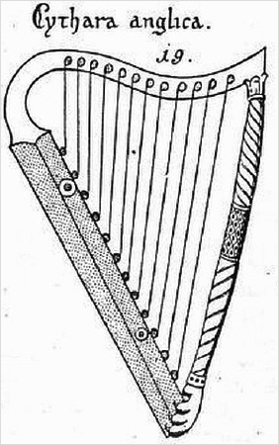
Harp build & styles
3 pieces- sound box carved from single large log (not willow). All 3 parts held together by the tension of the brass strings.4th piece at back.
European harp –gut string, lighter, less strings, no distinctive social function. Ladies’ instrument.
Irish repertoire unique, different from the continent.
Played with long fingernails , with left hand top, right hand bottom, left shoulder(?) playing close to soundboard.
Played in “animated manner, not slow & solemn…but rapid and lively”. Bass lines move in parallel to treble-relic of medieval technique of heterophony.

Slide 7
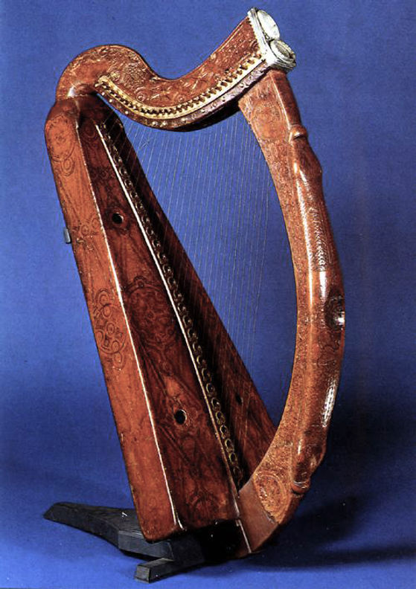
16th Century
Like European harps, Irish harps became gradually larger until the 17thc. And then taller and thinner into the 19thc.
Big size provided longer bass strings and a more powerful bass register to follow music trends.(Trinity Harp/Brian Boru harp)-15thc. sycamore, O’Neill harp, Queen Mary harps.
Politics & rebellion: Edict 1603 (following Battle of Kinsale): required the Munster marshal to execute any vagrants, beggars, rhymers , bards and harpers who couldn’t prove who his master was. (possible spies) Greater restrictions, fewer patrons.

Slide 8
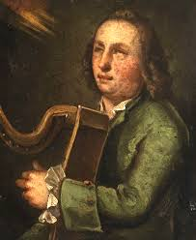
Travelling harpers
After edict -Breakup of the Irish courts and nobles led to the unravelling of the traditional system of Irish harp patronage .
Made worse by Penal Laws. Harpers forced to become itinerant, providing popular music and general entertainment in return for food, wine, whiskey, clothes and somewhere to lodge temporarily.
Families offered a warm welcome to the best harpists, but paid mostly in kind (other musicians paid cash).
Gradually old Gaelic repertoire lost, replaced by the lighter music of popular tunes and dance music of Europe
Turlough O’Carolan, 1670-1738. Poet, composer, wit and friend of renown people -became extremely popular. Composed tune first and then thought up words- reversal of age old tradition.

Slide 9
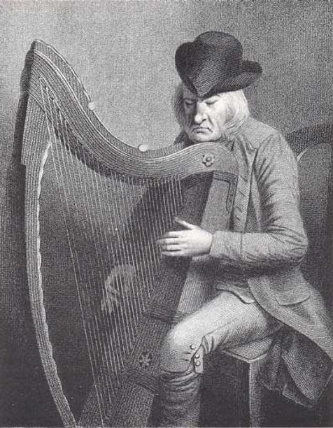
1792 Belfast Harp Festival
Harp known as a symbol of Irish culture home & abroad. Set up a festival with the idea of preventing the decline of the Irish harping tradition.
11 harpers ranging in ages 15 to 97 playing pieces in their own particular style.
Dennis Hempson, age 97, only one to play in the old style with long nails on brass strings. He refused to play anything but Irish music.
Edward Bunting was commissioned by Belfast Harp Society to record music & lifestyles. This method didn’t allow for nuances and some were lost.
It’s through Bunting that we know anything of the music that existed before the festival.

Slide 10
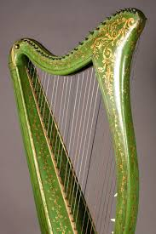
19th century parlour music
Facing extinction, in early 19thc. an attempt to revive harp linked research of ancient bardic music to fashion for upper-class women to play the French harp.
In 1820 harp maker John Egan began selling Royal Portable Harps—built like a smaller French harp and equipped with little finger levers for sharps/flats at the pillar, instead of foot pedals of French harp, to play the modern 19thc musical style.
Made to suggest ancient bardic instrument: painted green with golden shamrocks- helped contribute to national pride and preservation of national culture.
Played music from Bunting’s publications.
Ultimately harp music formed the third division of Irish music, wedged between professional classic music and folk music.

Slide 11
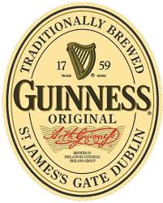
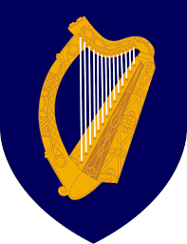
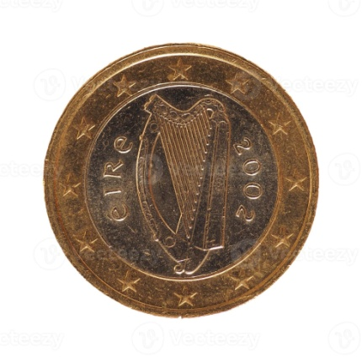
National emblem
Incorporated increasingly into symbols of Irish culture.
e.g.Harp put on Guinness label in 1862- derived from Trinity harp. They also own Denis Hempson’s harp, made in 1702- the Downhill harp made of alder.
The harp became the symbol of rebellion during the 19th c. and with the formation of the Irish Free State (1922) it became the official emblem of Ireland.
Used on Irish euro coins 2005.

Slide 12
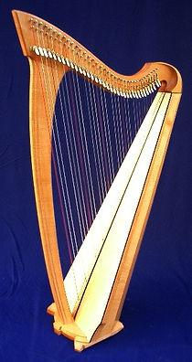
Harp revival
Harp confined mostly to drawing room & traditional music events and regions in first half of 20th c.
Derek Bell and Chieftains- helped renewal of interest in Irish traditional music, including harp.
Maire Ni Chaithasaigh, Grainne Yeats and others-technique in historical context.
The 20th c. successor to Egan’s harp, the modern Celtic harp/Neo-Irish harp/lever harp created. Smaller, lighter-weight, simplified version of a modern orchestral harp. Style of playing like orchestral harp usually elbows out, fingers in contact good distance from soundboard, etc.
Now, harp very much a part of the Irish music culture at home and abroad. Legacy and importance recognised.

